Slide 1

Project on Consumer Goods Domain
Presentation by:
Rakesh Pawar G

Slide 2

Problem Statement:
Atliq Hardwares (imaginary company) is one of the leading computer hardware producers in India and well expanded in other countries too.
However, the management noticed that they do not get enough insights to make quick and smart data-informed decisions. They want to expand their data analytics team by adding several data analysts. Tony Sharma, their data analytics director wanted to hire someone who is good at both tech and soft skills. Hence, he decided to conduct a SQL challenge which will help him understand both the skills.

Slide 3
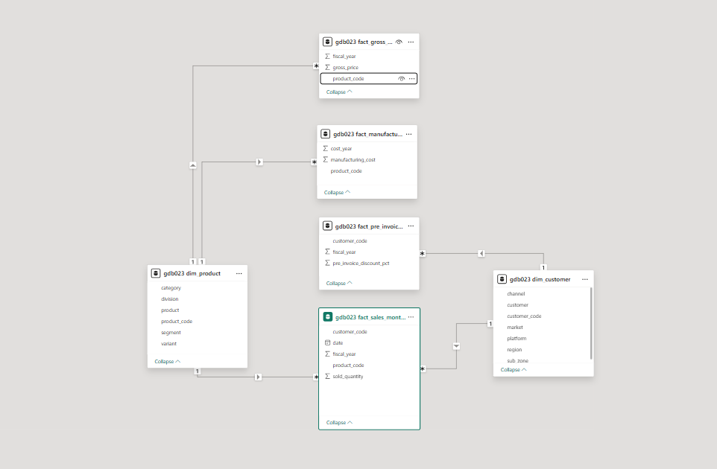
Understanding Available Data:

Slide 4

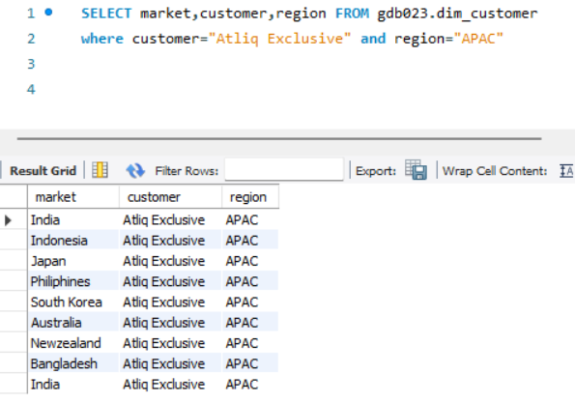
Requests:
Provide the list of markets in which customer "Atliq Exclusive" operates its business in the APAC region.
Query→
SELECT market,customer,region FROM gdb023.dim_customer
where customer="Atliq Exclusive" and region="APAC"

Slide 5
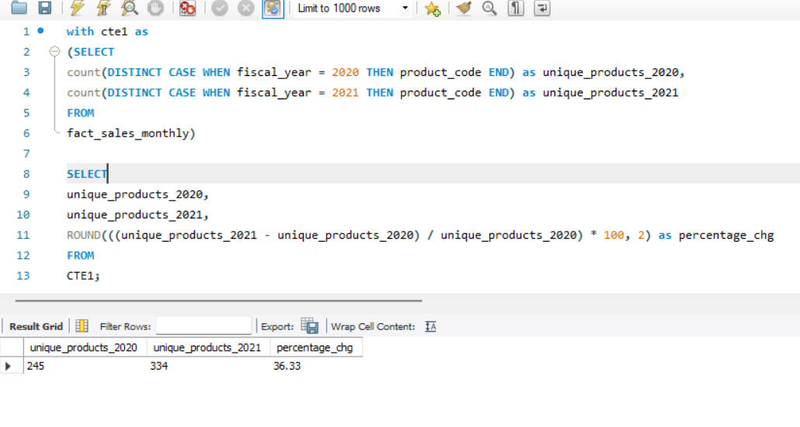
Requests:
2. What is the percentage of unique product increase in 2021 vs. 2020? The final output contains these fields,
unique_products_2020 unique_products_2021 percentage_chg
Query→

Slide 6
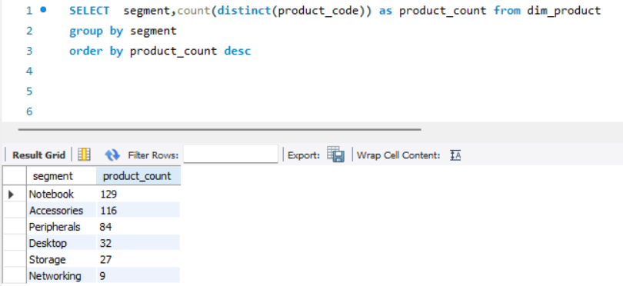
Requests:
3.Provide a report with all the unique product counts for each segment and sort them in descending order of product counts. The final output contains 2 fields,
Segment, product_count
Query→
SELECT segment,count(distinct(product_code)) as prod_count from dim_product
group by segment
order by prod_count desc

Slide 7

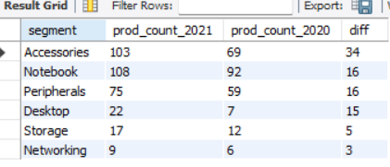
Requests:
4.Follow-up: Which segment had the most increase in unique products in 2021 vs 2020? The final output contains these fields,
segment product_count_2020 product_count_2021 difference
Query→
with cte1 as(
select p.segment,
count(distinct case when s.fiscal_year=2021 then s.product_code end) as prod_count_2021,
count(distinct case when s.fiscal_year=2020 then s.product_code end) as prod_count_2020
from fact_sales_monthly s
join dim_product p
on p.product_code=s.product_code
group by p.segment)
select *,(prod_count_2021-prod_count_2020) as diff
from cte1

Slide 8
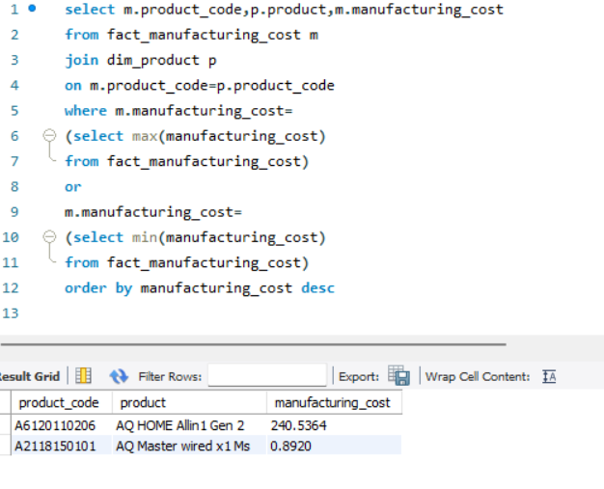
Requests:
5.Get the products that have the highest and lowest manufacturing costs. The final output should contain these fields,
product_code , product , manufacturing_cost
Query→

Slide 9
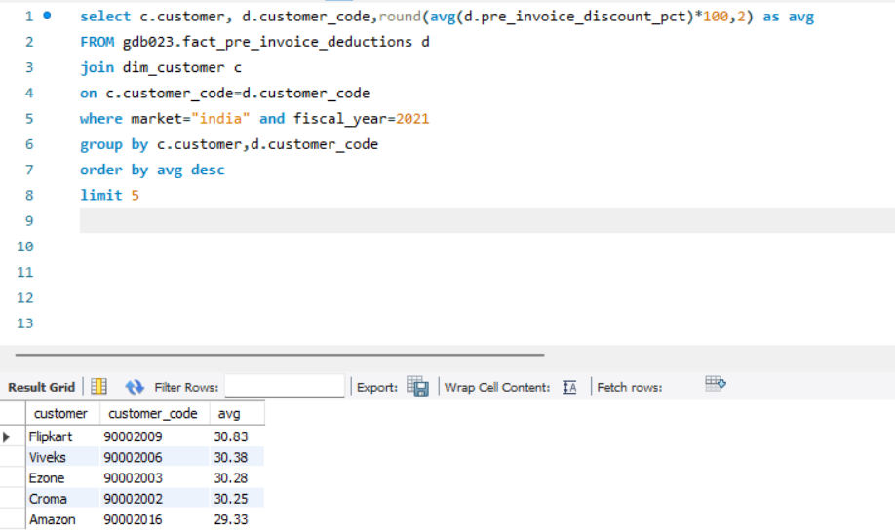
Requests:
6. Generate a report which contains the top 5 customers who received an average high pre_invoice_discount_pct for the fiscal year 2021 and in the Indian market. The final output contains these fields,
customer_code, customer ,average_discount_percentage

Slide 10

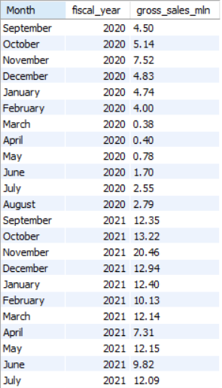
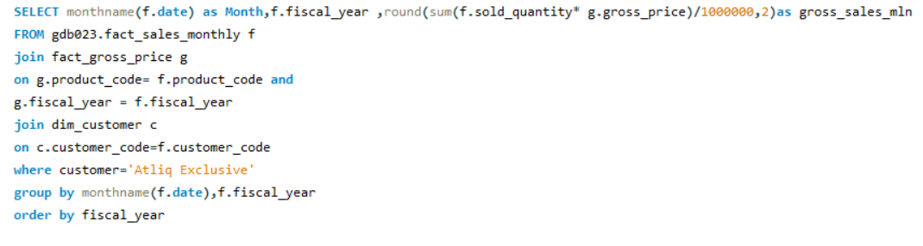
Requests:
7. Get the complete report of the Gross sales amount for the customer “Atliq Exclusive” for each month. This analysis helps to get an idea of low and high-performing months and take strategic decisions.
The final report contains these columns:
Month
Year
Gross sales Amount

Slide 11
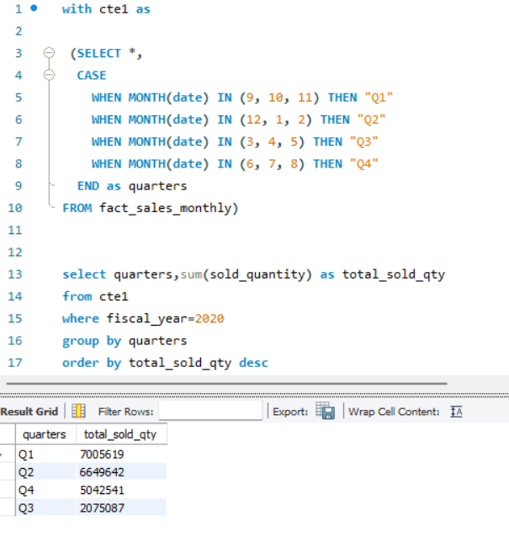
Requests:
8.In which quarter of 2020, got the maximum total_sold_quantity? The final output contains these fields sorted by the total_sold_quantity,
Quarter
total_sold_quantity

Slide 12
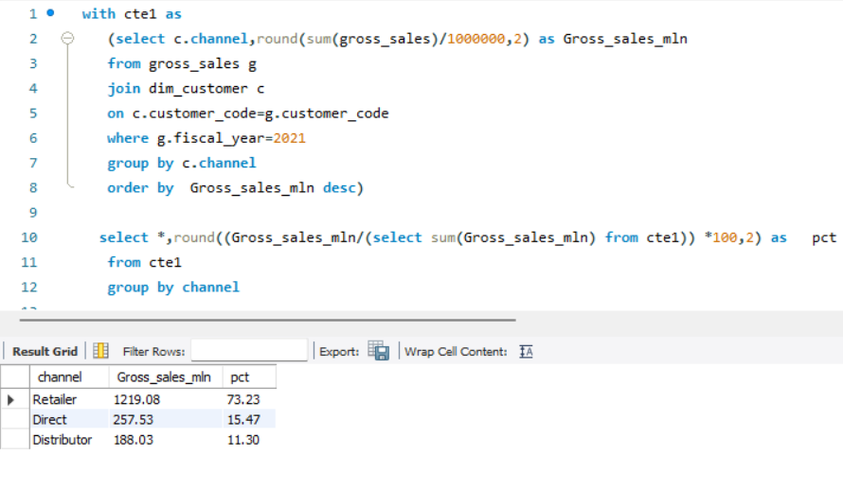
Requests:
9.Which channel helped to bring more gross sales in the fiscal year 2021 and the percentage of contribution? The final output contains these fields,
channel gross_sales_mln percentage

Slide 13
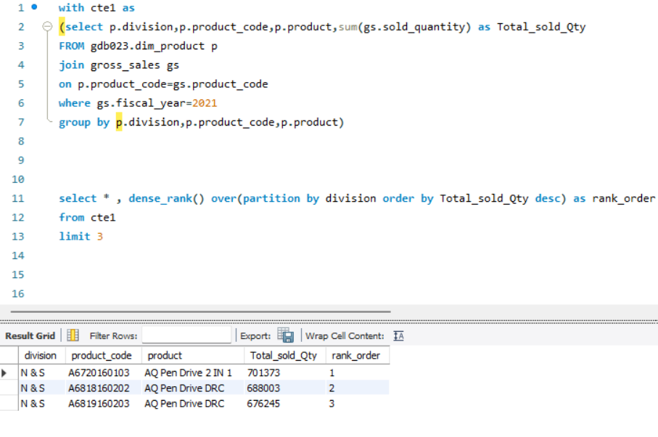
Requests:
10. Get the Top 3 products in each division that have a high total_sold_quantity in the fiscal_year 2021? The final output contains these fields,
division product_code product total_sold_quantity rank_order

Slide 14
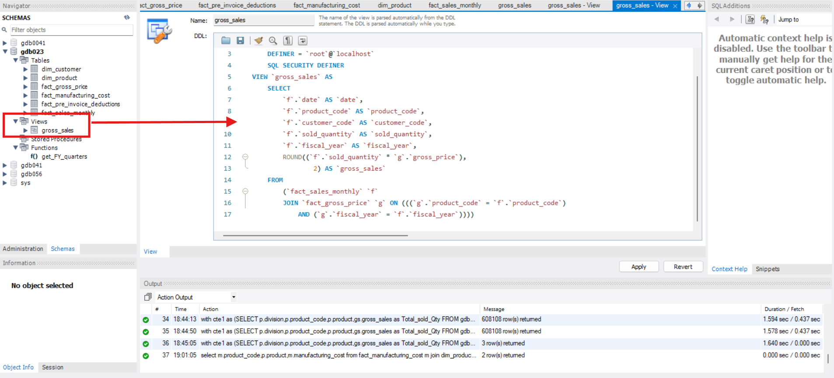
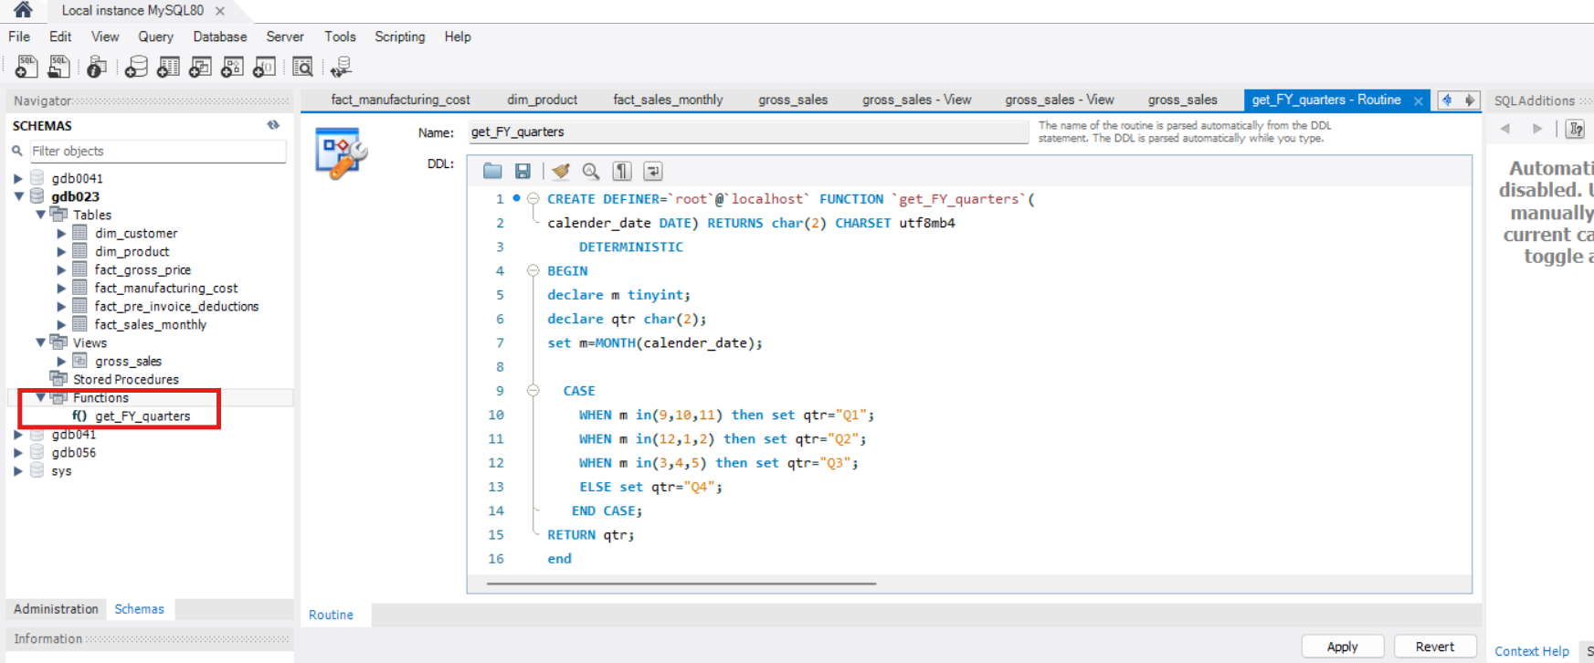
Created Views
(For query re-usability for Gross_sold_price).
Created User defined functions

Slide 15
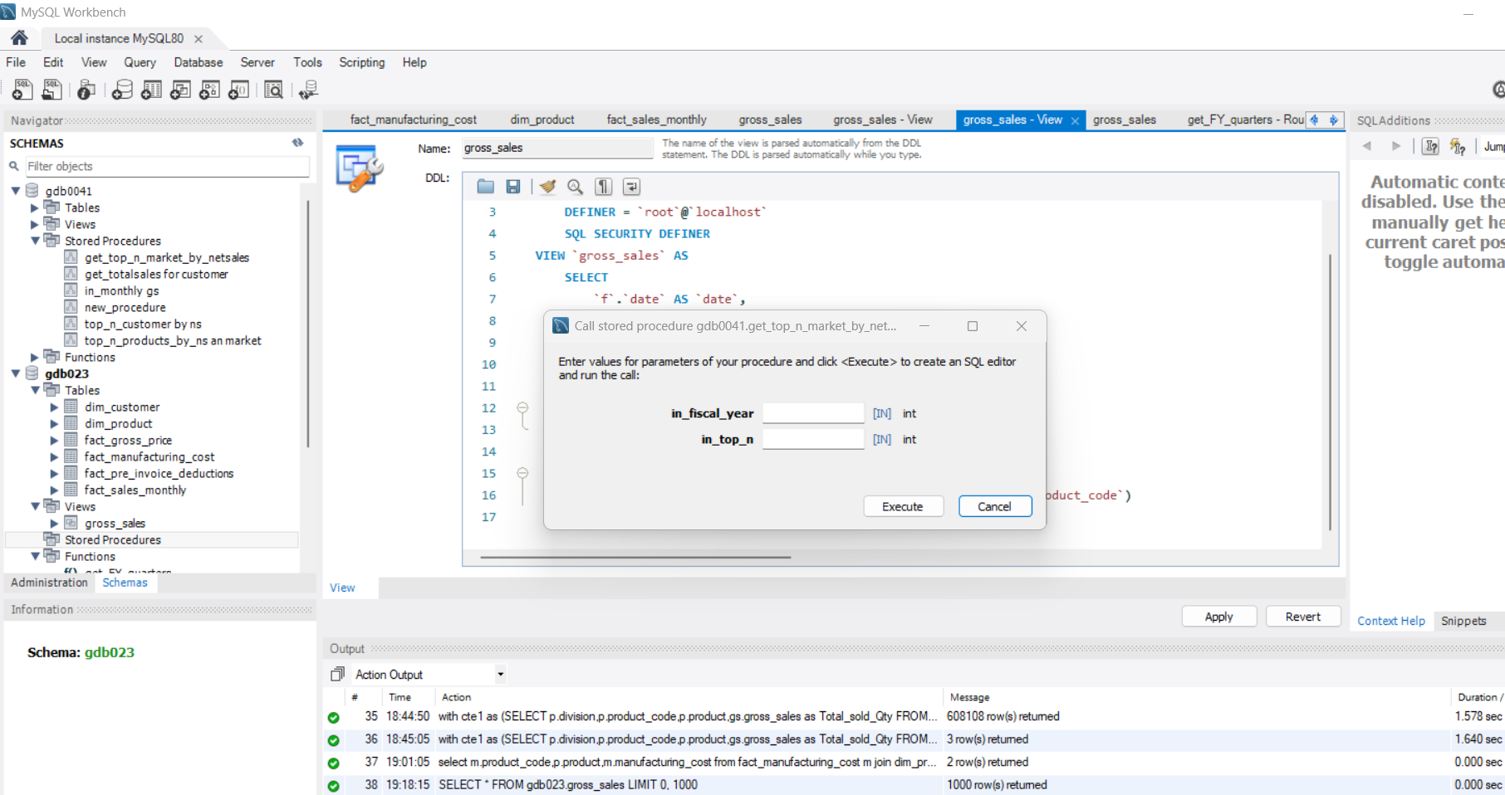
Created Stored Procedures

Slide 16
Highlighted Insights
When Compared with Unique Product for 2020 & 2021 found 36.33% Hike in new products in 2021
Notebook in segment has major variety products around 129 unique varients
Out of unique products YOY 2020 &2021 Majorly products are from Accessories,Notebook & Peripherals
My Maximum and minimum manufacturing cost are respectively from Product AQ Home Allin Gen2 240.53 $ and AQ Master Wired x1 Ms with $0.8920
My Top 5 Customers who received Max Pre_Invoice Discount are Flipkart with (30.83 Approx 31%)
Viveks with (30.38 Approx 31%)
Ezone with (30.28 Approx3 30%)
Croma with (30.25 Approx 30%)
Amazon with (29.33 Approx 30%)
There is Fluctuation in Atliq Exculisive customers Gross price with major downfall during Mar-Aug 2020 due to Covid-19
Q1 of 2020 holds highest sold quantities might be Diwali and New year timeline
Retailers in 2021 brought us more gross sales with 73% then Direct with 15% and Distrubutors brought around 12% gross sales.

